Slide 1
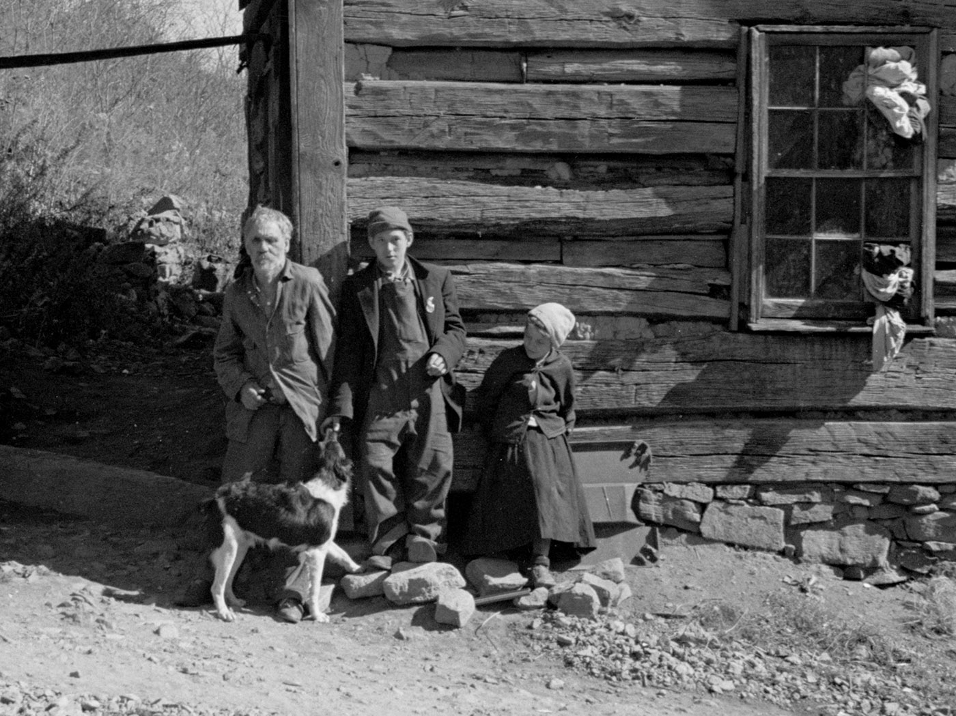
FOOD, POWER and EUGENICS
in the BLUE RIDGE
29 Oct 2024, WLU
Glenn Davis Stone and Richard Knox Robinson
WLU Anthropology Ekphratic Productions

